Slide 1


ADVENTURE WORKS
SALES ANALYTICS PROJECT
ADVENTURE WORKS
End-to-End Data Analytics using
Excel • SQL • Power BI • Tableau
▦
◈
EXCEL
SQL
Data Preparation
Data Queries
DATA PREPARATION
DATA MODELING
DAX & SQL
BUSINESS ANALYSIS
◫
◉
From raw data to business insights — one integrated analytics workflow.
POWER BI
TABLEAU
Dashboarding
Visualization
PROJECT PRESENTATION
Data Cleaning → Modeling → Analysis → Visualization → Dashboard
1

Slide 2
TEAM MEMBERS – GROUP 4
Adventure Works Sales Analytics Project
1
PRAMOD
2
Pratiksha
PROJECT TEAM
Excel • SQL
Power BI • Tableau
Data Preparation
Data Modeling
Analysis • Visualization
Dashboard & Insights
Anuradha
3
Ruby
4
Aditi
5
Excel • SQL • Power BI • Tableau
2

Slide 3

PROJECT OVERVIEW
Adventure Works Sales Analytics • Excel • SQL • Power BI • Tableau
ABOUT THE PROJECT
Adventure Works Cycles is a fictional multinational bicycle manufacturer and seller. This project transforms raw sales data into business insights across products, customers, regions and time, using Excel, SQL, Power BI and Tableau.
DATA MODELING
SQL ANALYSIS
VISUALIZATION
POWER QUERY
Star-schema model with Fact Sales and dimension tables.
13 business questions solved with queries, joins, dates and aggregations.
Excel, Tableau and Power BI dashboards with KPIs, charts and slicers.
Data cleaning, append/merge, transformations and calculated fields.
DATA MODEL
Fact_Sales → DimCustomer | DimProduct | DimDate | DimSalesTerritory
TOOLS
QUESTIONS
CORE OUTPUTS
DASHBOARDS
4
13
Sales • Profit • Cost
Excel • Tableau • Power BI
ADVENTURE WORKS • DATA ANALYTICS PROJECT
2026
3

Slide 4
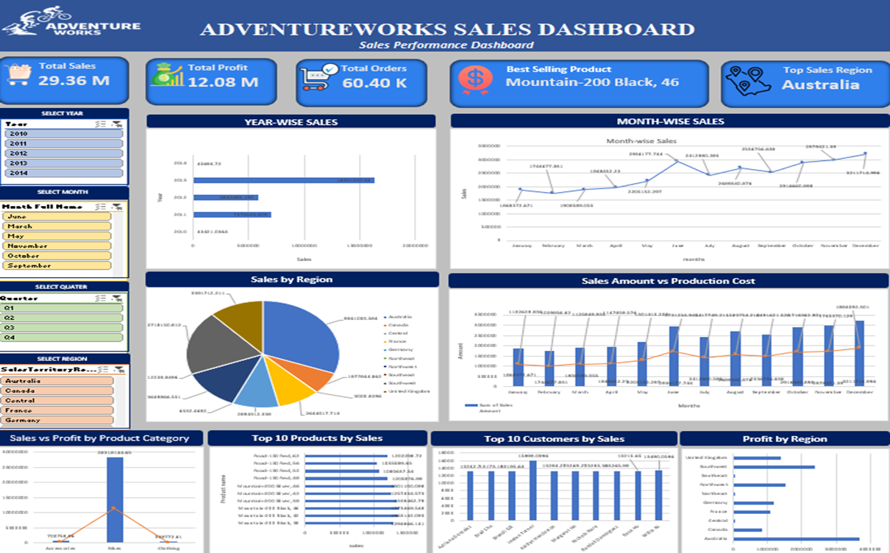
EXCEL DASHBOARD
MICROSOFT EXCEL
Microsoft Excel | Pivot Tables • Charts • Slicers
YEAR-WISE SALES
Column / Bar Chart
MONTH-WISE SALES
Line Chart
REGION SALES
Pie chart
SALES VS PROD COST
Combination Chart
KPI’S
• Total Sales • Total Profit • Total Orders • Best Selling Product
• Top Sales Region
FILTERS
• Year • Month • Quarter • Region
Excel workflow: Data Preparation → Pivot Analysis → Interactive Dashboard → Business Insights
ADVENTURE WORKS • DATA ANALYTICS PROJECT
2026
4

Slide 5

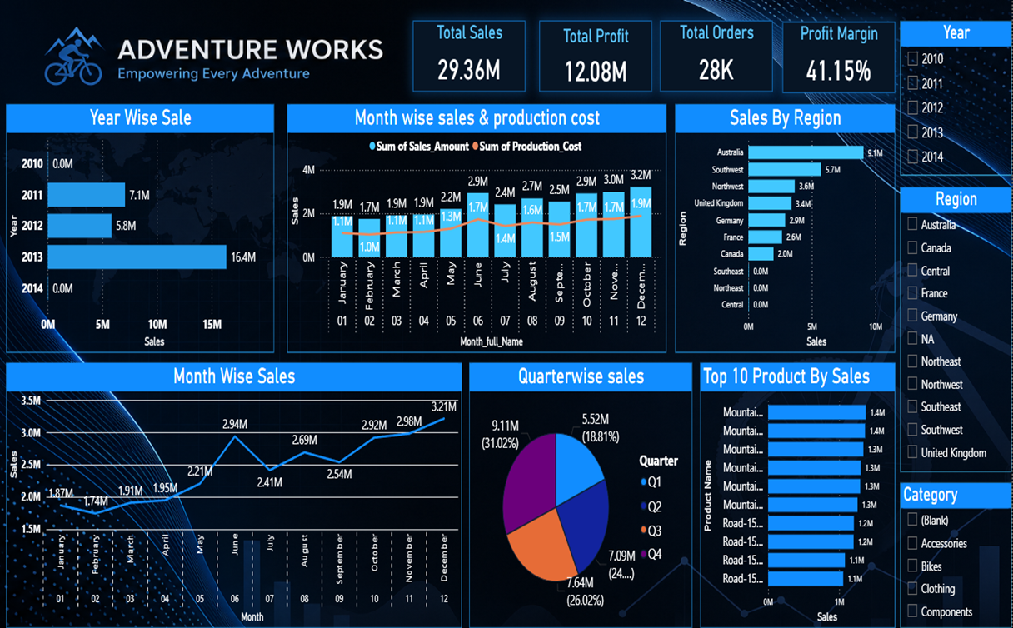
POWER BI DASHBOARD
MICROSOFT POWER BI
Microsoft Power BI | Power Query • DAX • Data Modeling
KPI DASHBOARD
Total Sales • Profit • Orders • Margin
YEAR-WISE SALES
Annual Sales Performance
REGIONAL PERFORMANCE
Sales by Region
QUARTER-WISE SALES
Quarter Sales Performance
TOP 10 PRODUCTS
Product Performance
SALES VS PROD COST
Sales Amount vs Production Cost
Power BI workflow: Power Query → Data Model → DAX → Interactive Dashboard → Business Insights
ADVENTURE WORKS • DATA ANALYTICS PROJECT
2026

Slide 6

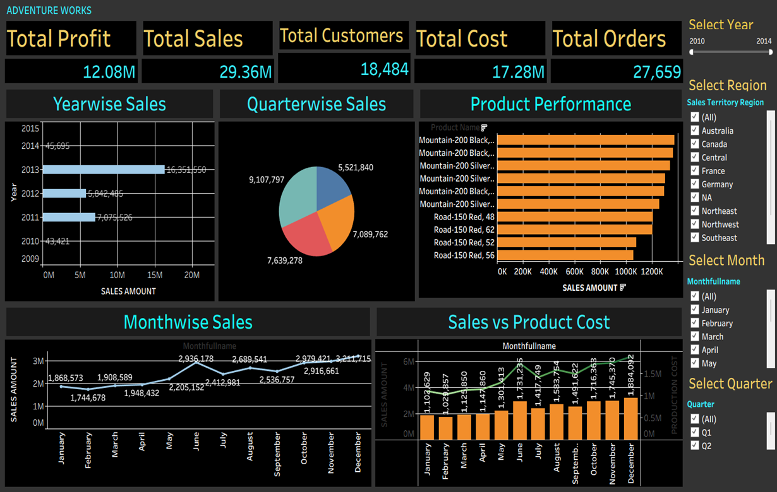
TABLEAU DASHBOARD
TABLEAU
Tableau | Calculated Fields • Filters • Interactive Visualizations
YEAR-WISE SALES
Sales by Year
MONTH-WISE SALES
Monthly Sales Trend
QUARTER-WISE SALES
Quarter Contribution
SALES VS PRODUCT COST
Monthly Sales and Product Performance
FILTERS
• Year • Region • Month • Quater
REGIONAL SALES
Regional Performance
Tableau workflow: Data Preparation → Calculated Fields → Interactive Dashboard → Business Insights
ADVENTURE WORKS • DATA ANALYTICS PROJECT
2026

Slide 7

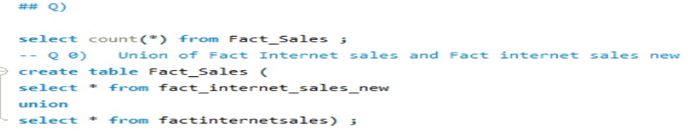
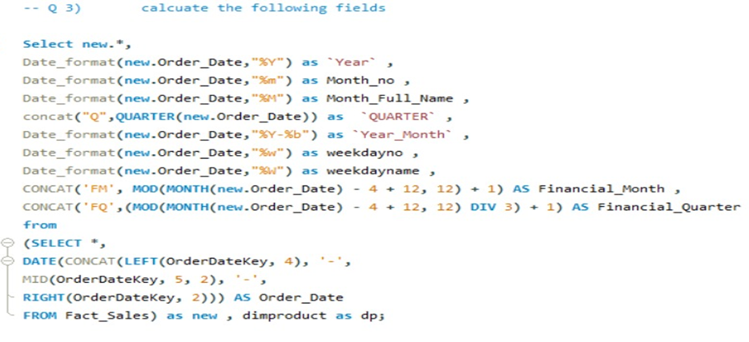
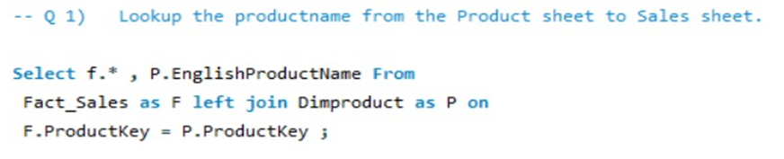
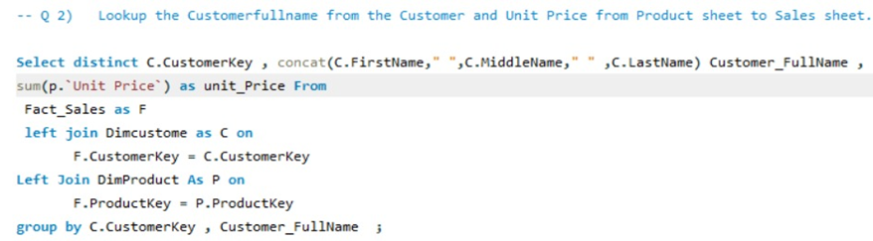
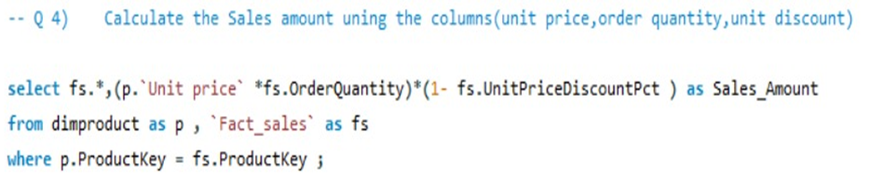
SQL QUERIES — Q0 TO Q6
MySQL | Data Transformation & Calculated Columns
Q0 — Union of Both Sales Tables
Q3 — Date Columns from OrderDateKey
Q1 — Lookup Product Name
Q2 — Lookup Customer Name & Unit Price
Q4 — Sales Amount
AdventureWorks Cycles | Sales Analysis | Group - 4

Slide 8

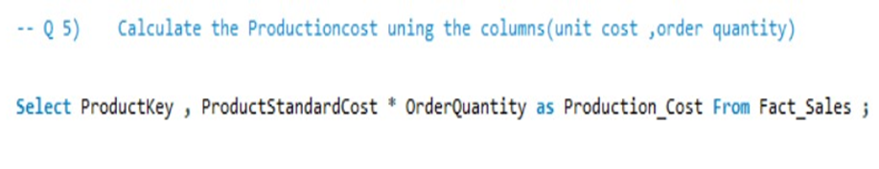
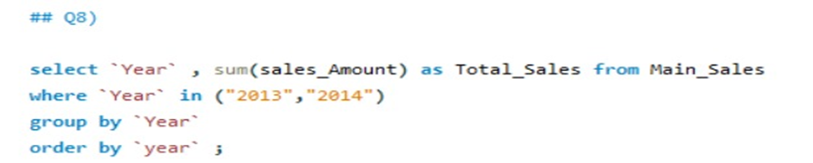
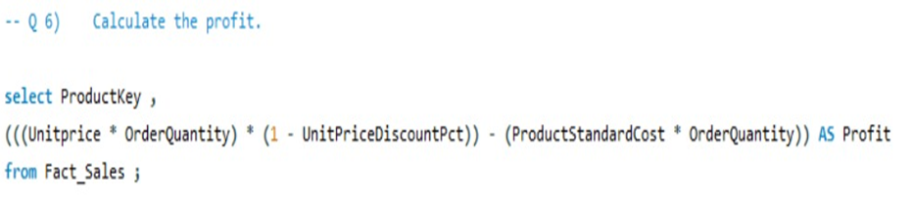
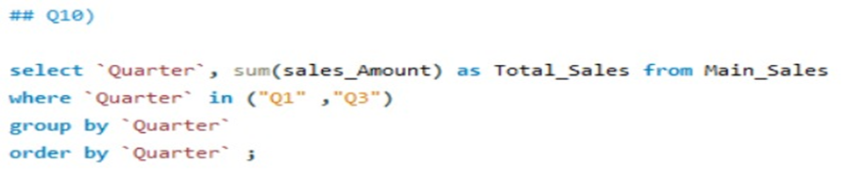
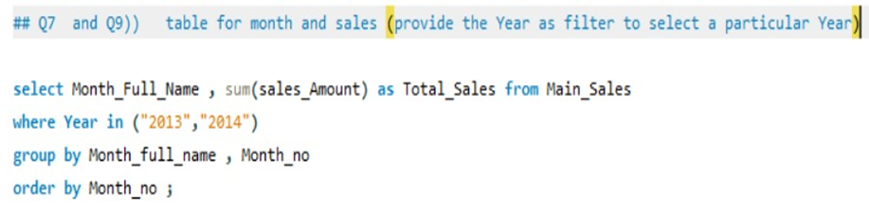
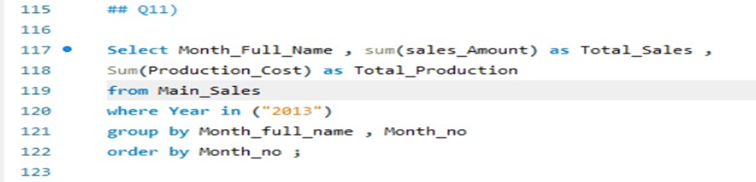
SQL QUERIES — Q5 TO Q11
MySQL | Data Transformation & Calculated Columns
Q5 — Production Cost
Q8 – Year-Wise Sales
Q6 — Profit Calculation
Q10- Quarter-Wise Sales
Q7 & 9 — Table for Month and Sales
Q11- Sales VS Production Cost
AdventureWorks Cycles | Sales Analysis | Group - 4

Slide 9

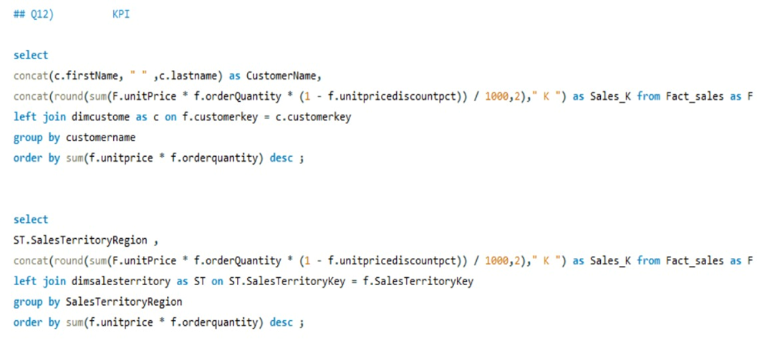
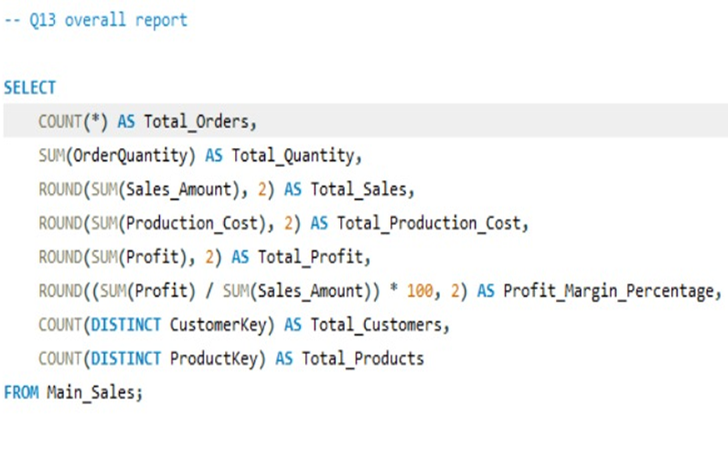
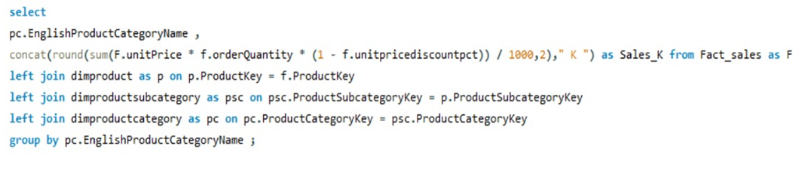
SQL QUERIES — Q12 & Q13
MySQL | Data Transformation & Calculated Columns
Q12— KIP’S Development
Q13 — Overall Report
AdventureWorks Cycles | Sales Analysis | Group - 4

Slide 10

KEY INSIGHTS
Adventure Works Sales Analysis | 2010–2014
29.36M
12.08M
60.40K
41.15%
₹486.09
Total Sales
Total Profit
Total Orders
Profit Margin
Avg Order Value
1
Peak Year: 2013
2
Top Region: Southwest
3
Top Product
2013 recorded the highest annual sales at approximately 16.4M, representing the strongest year in the analysis period.
Southwest led regional performance. Australia was the strongest international market by sales.
Mountain-200 Black (42) was the best-selling product at roughly 1.37M, with mountain bikes dominating the top performers.
4
Top Customer
5
Q4 Peaks Sales
6
Sales > Cost
Jordan Turner led customer purchases at about 16.0K, while the top customers were closely grouped.
Q4 consistently delivered the strongest quarterly sales, indicating a clear year-end seasonal effect.
Production cost remained below sales across the period, supporting a healthy overall margin of about 41%.
Adventure Works Cycles | Key Insights | Excel • SQL • Power BI • Tableau | Group - 4

Slide 11

THANK YOU
Adventure Works Sales Analysis Project
Excel | SQL | Power BI | Tableau
AdventureWorks Cycles | Sales Analysis | Group - 4

